Slide 1
RWD
Responsive Web Design (RWD)
Xbi@eamv 2023

Slide 2
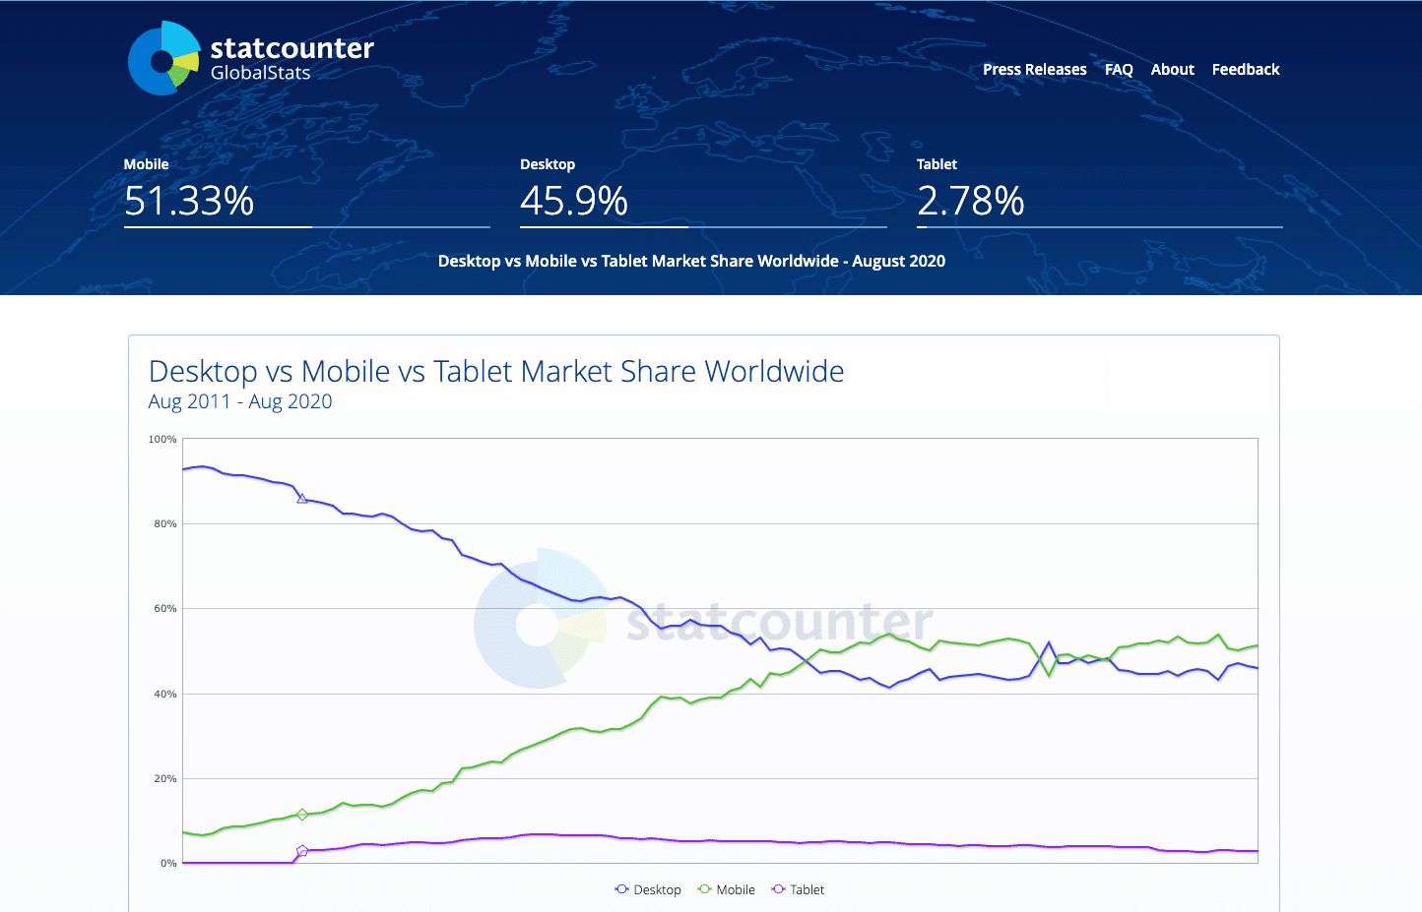
Why Responsive Design Matters

Slide 3
RWD
Responsive Web Design (RWD) is an approach to web design that aims to make web pages render well on a variety of devices and screen sizes.
RWD uses a combination of grids, flexible layout, and media queries to achieve a responsive layout

Slide 4
CSS Flex

Slide 5
CSS Flexbox as a powerful layout model. It is able to create flexible and responsive layouts with ease

Slide 6
Before flex. Is float

Slide 7
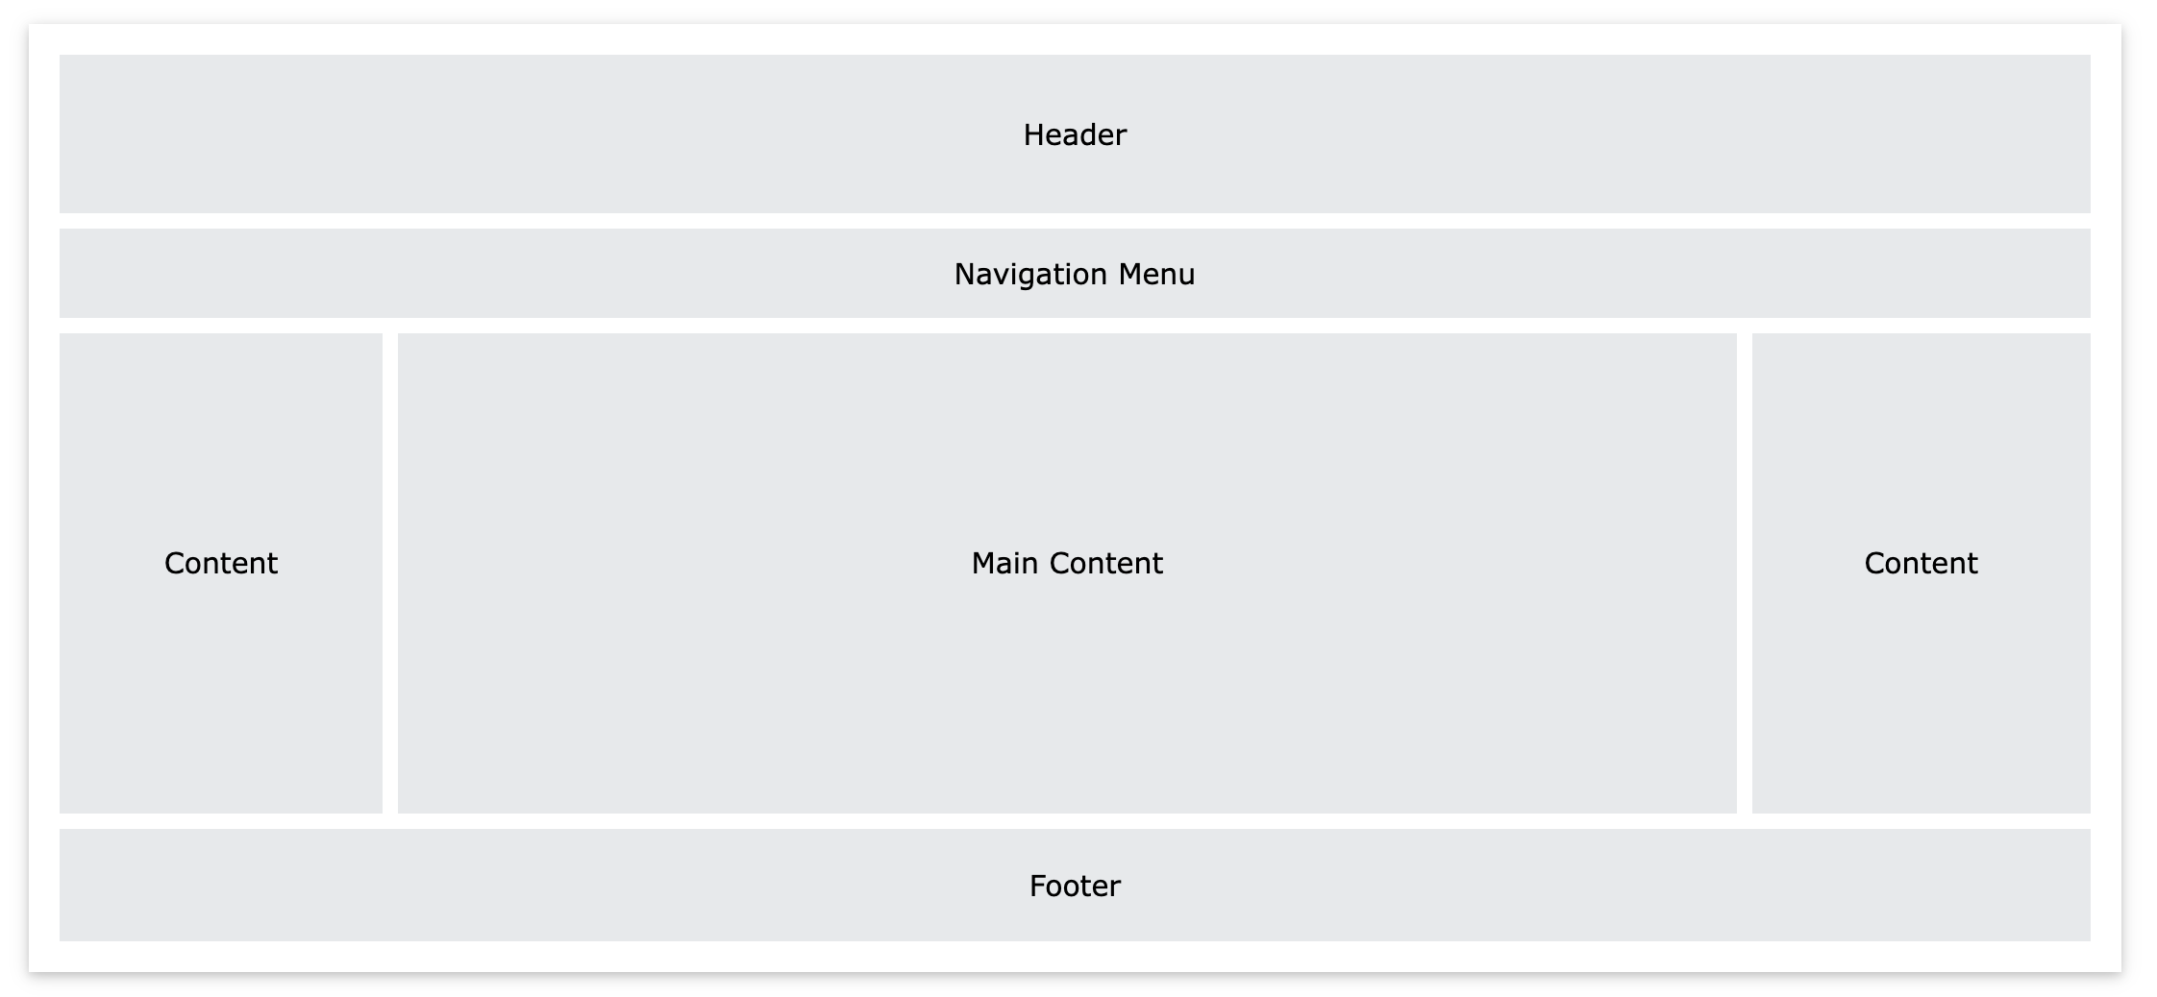

Slide 8
Se a float demo
https://www.w3schools.com/howto/tryit.asp?filename=tryhow_css_three_columns

Slide 9
Flexible Box Layout Module, makes it easier to design flexible responsive layout

Slide 10
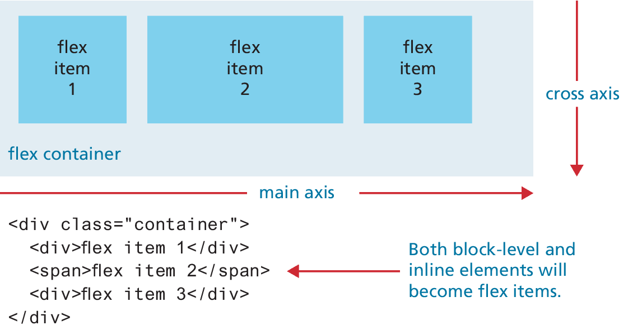
Flex containers and items
There are two places in which you will be assigning flexbox properties: the flex container and the flex items within the container.

Slide 11
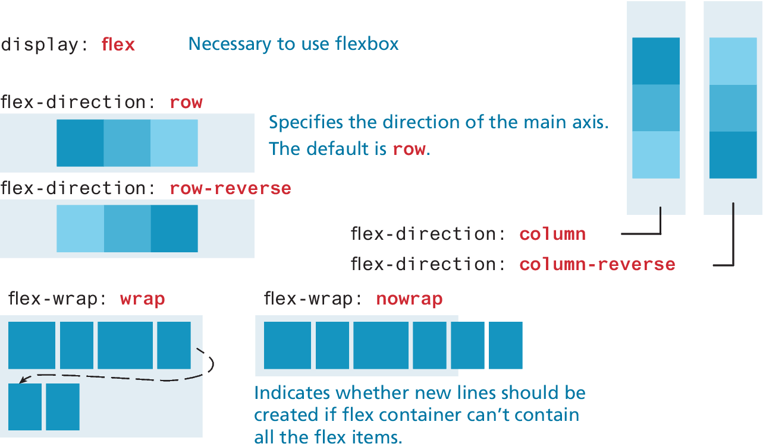
The flexbox container properties

Slide 12
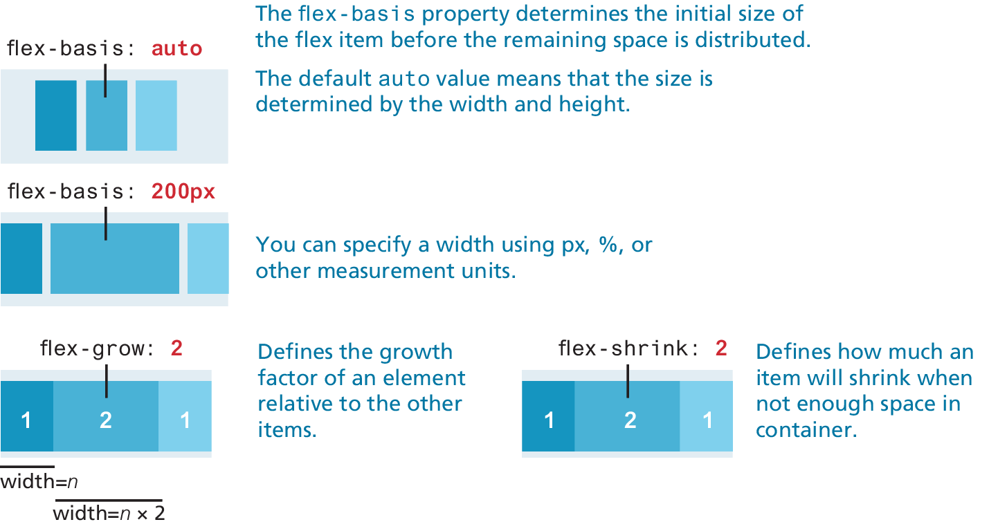
The flexbox item (child) properties

Slide 13
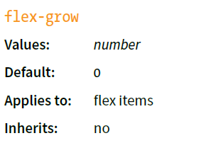
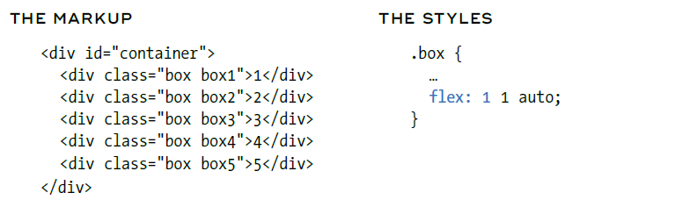
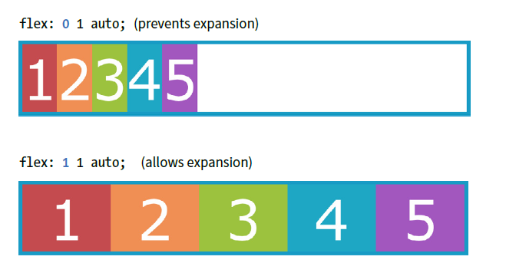
Flex grow container (0=no grow , 1=grow)
When flex-grow is set to 1, the extra space in the line is distributed
into the items in equal portions, and they expand to fill the space at the same rate.

Slide 14
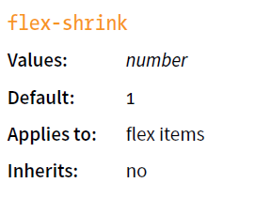
Flex-shrink
By default, the flex-shrink value is set to 1, which means
items shrink to fit at the same rate.

Slide 15
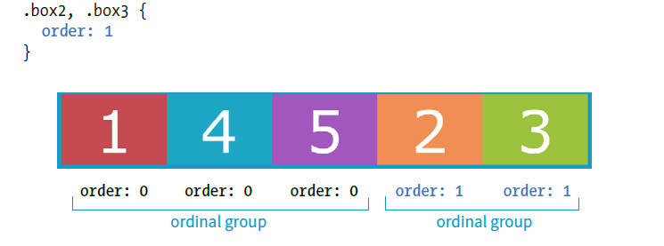
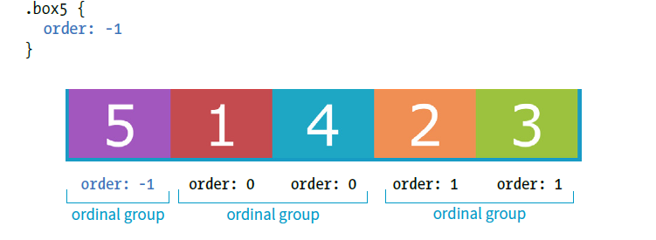
Positive order (default 0) Negative order
Notes:
https://codepen.io/tengmushitou/pen/JjydNKN

Slide 16
Hands-on Flex menu
flexnav.html
Notes:
nav ul {
margin: 0;
padding: 0;
list-style-type: none;
display: flex;
justify-content: center;
}
nav ul li a {
display: block;
border: 1px solid;
border-radius: .5em;
padding: .5em 1em;
margin: .5em;
}

Slide 17
CSS Grid

Slide 18
CSS Grid as another modern layout model. It is able to create grid-based layouts

Slide 19
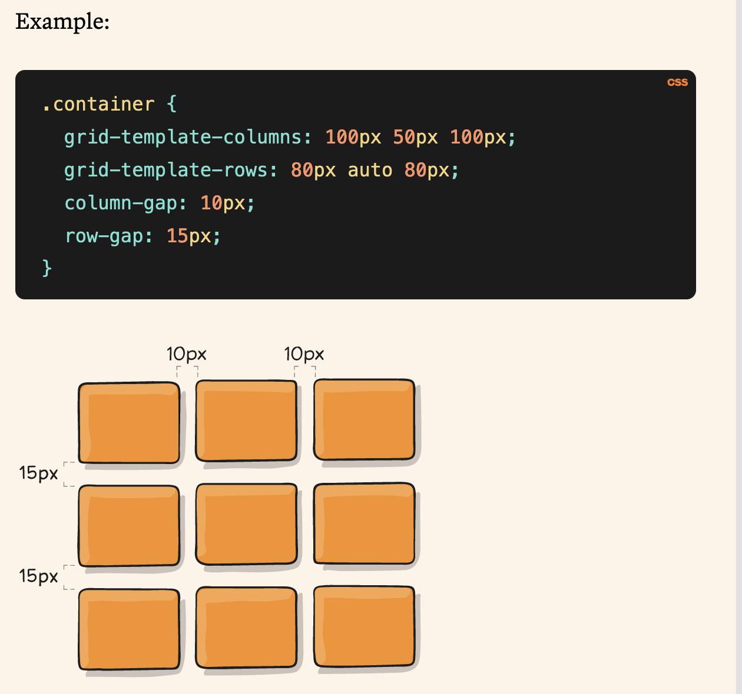
CSS grid
Source: https://css-tricks.com/snippets/css/complete-guide-grid/

Slide 20
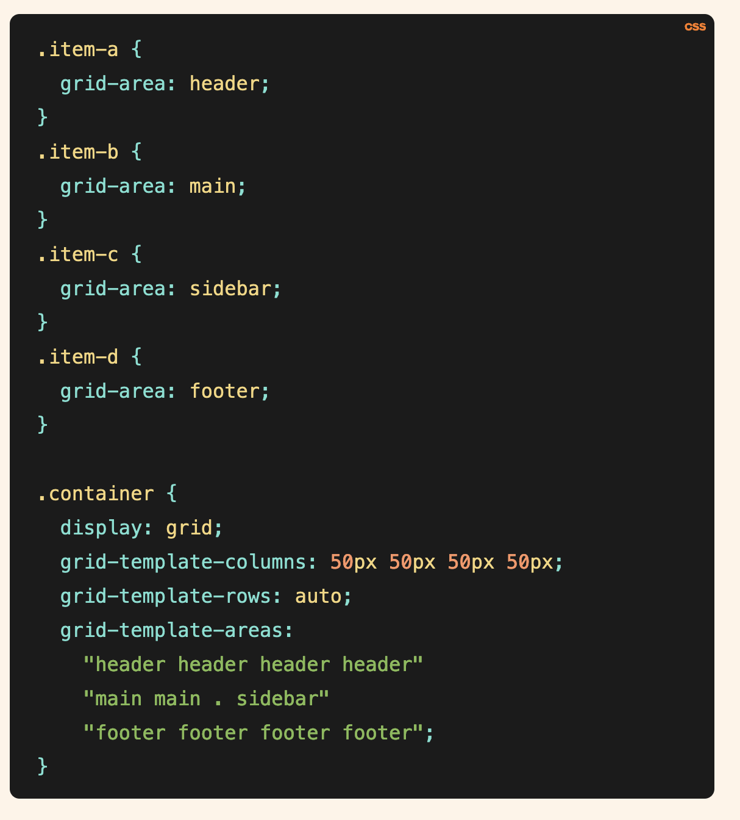
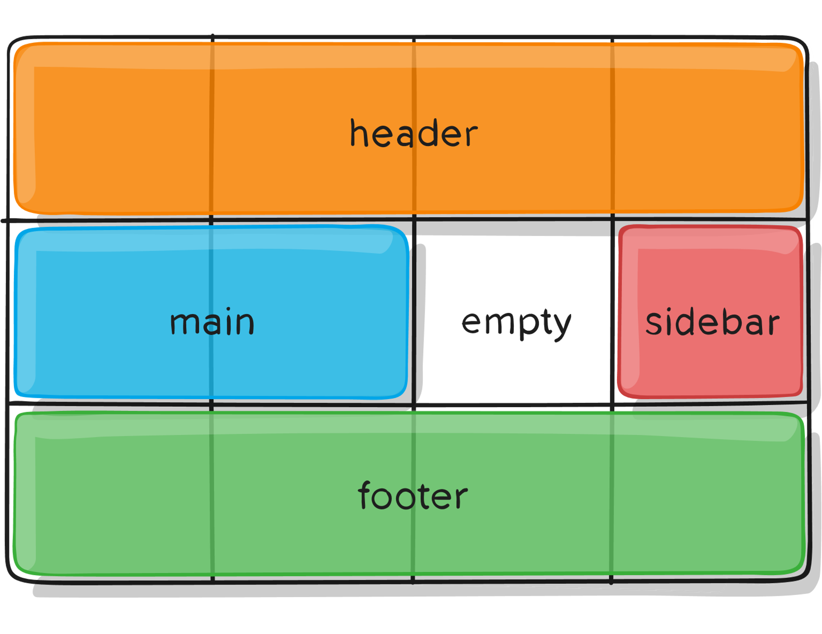
CSS grid-area
Source: https://css-tricks.com/snippets/css/complete-guide-grid/

Slide 21
Before grid. Is table

Slide 22
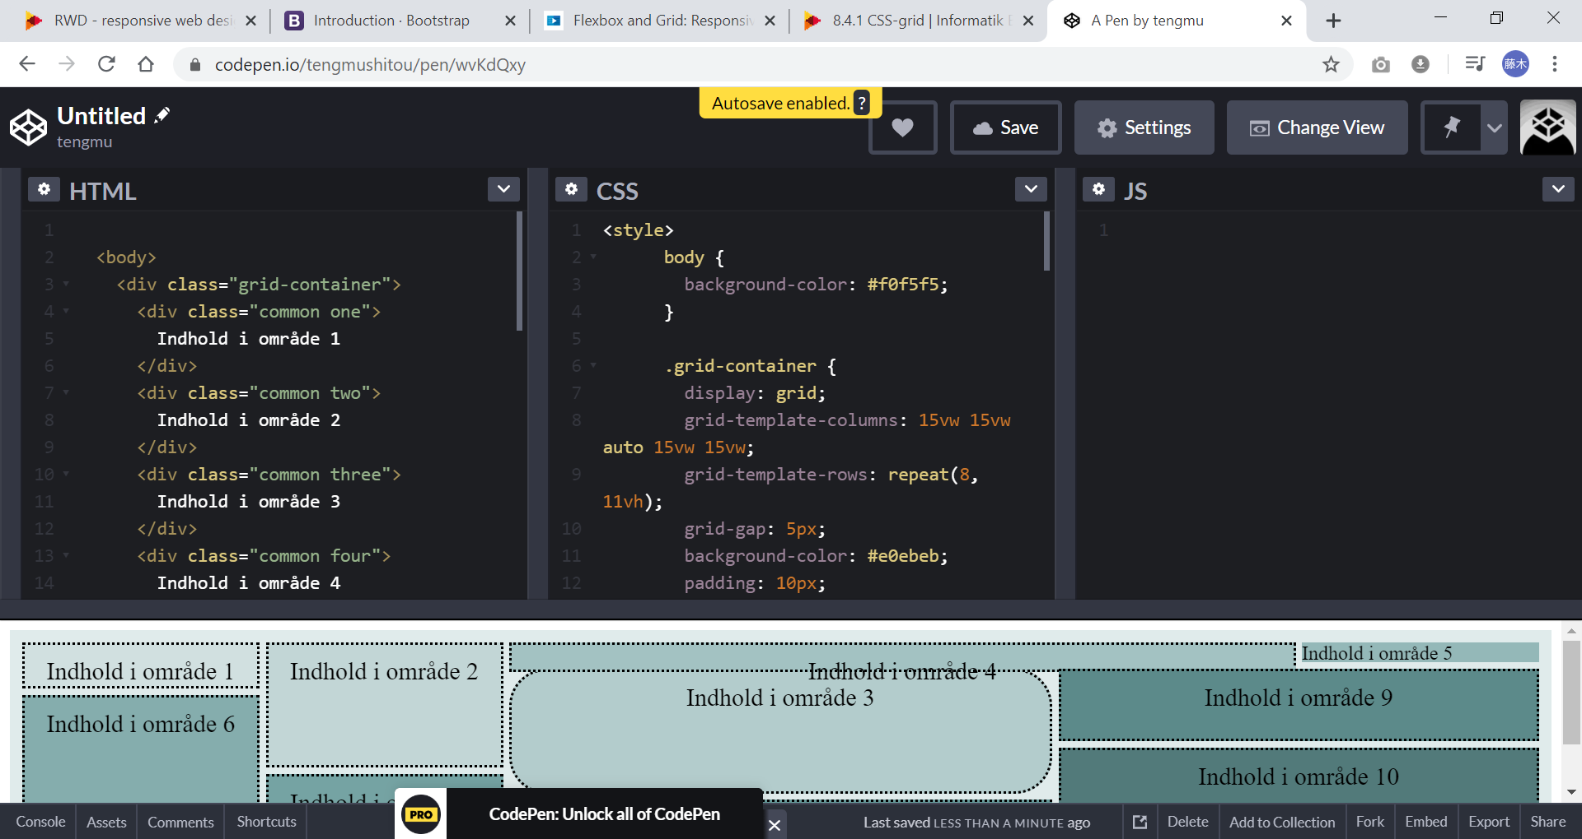
Hands-ON lave Grid Demo https://codepen.io/tengmushitou/pen/wvKdQxy
Notes:
https://codepen.io/tengmushitou/pen/wvKdQxy
Kode fra CSS Grid.doc

Slide 23
Tools: google chrome grid inspect

Slide 24
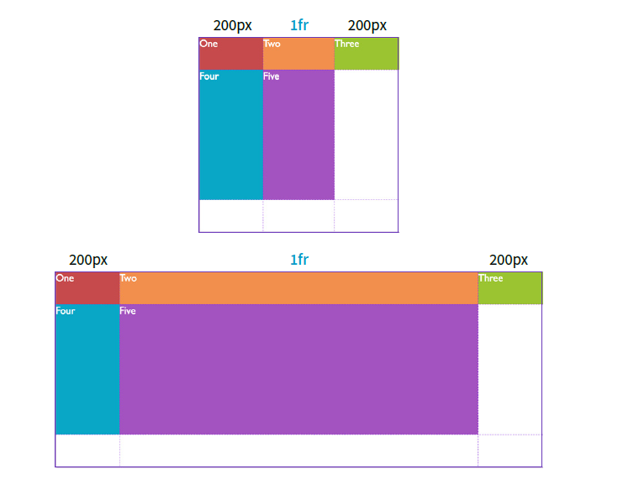
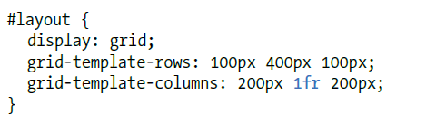
Grid fr vs. px
Notes:
https://css-tricks.com/introduction-fr-css-unit/

Slide 25
fredag

Slide 26
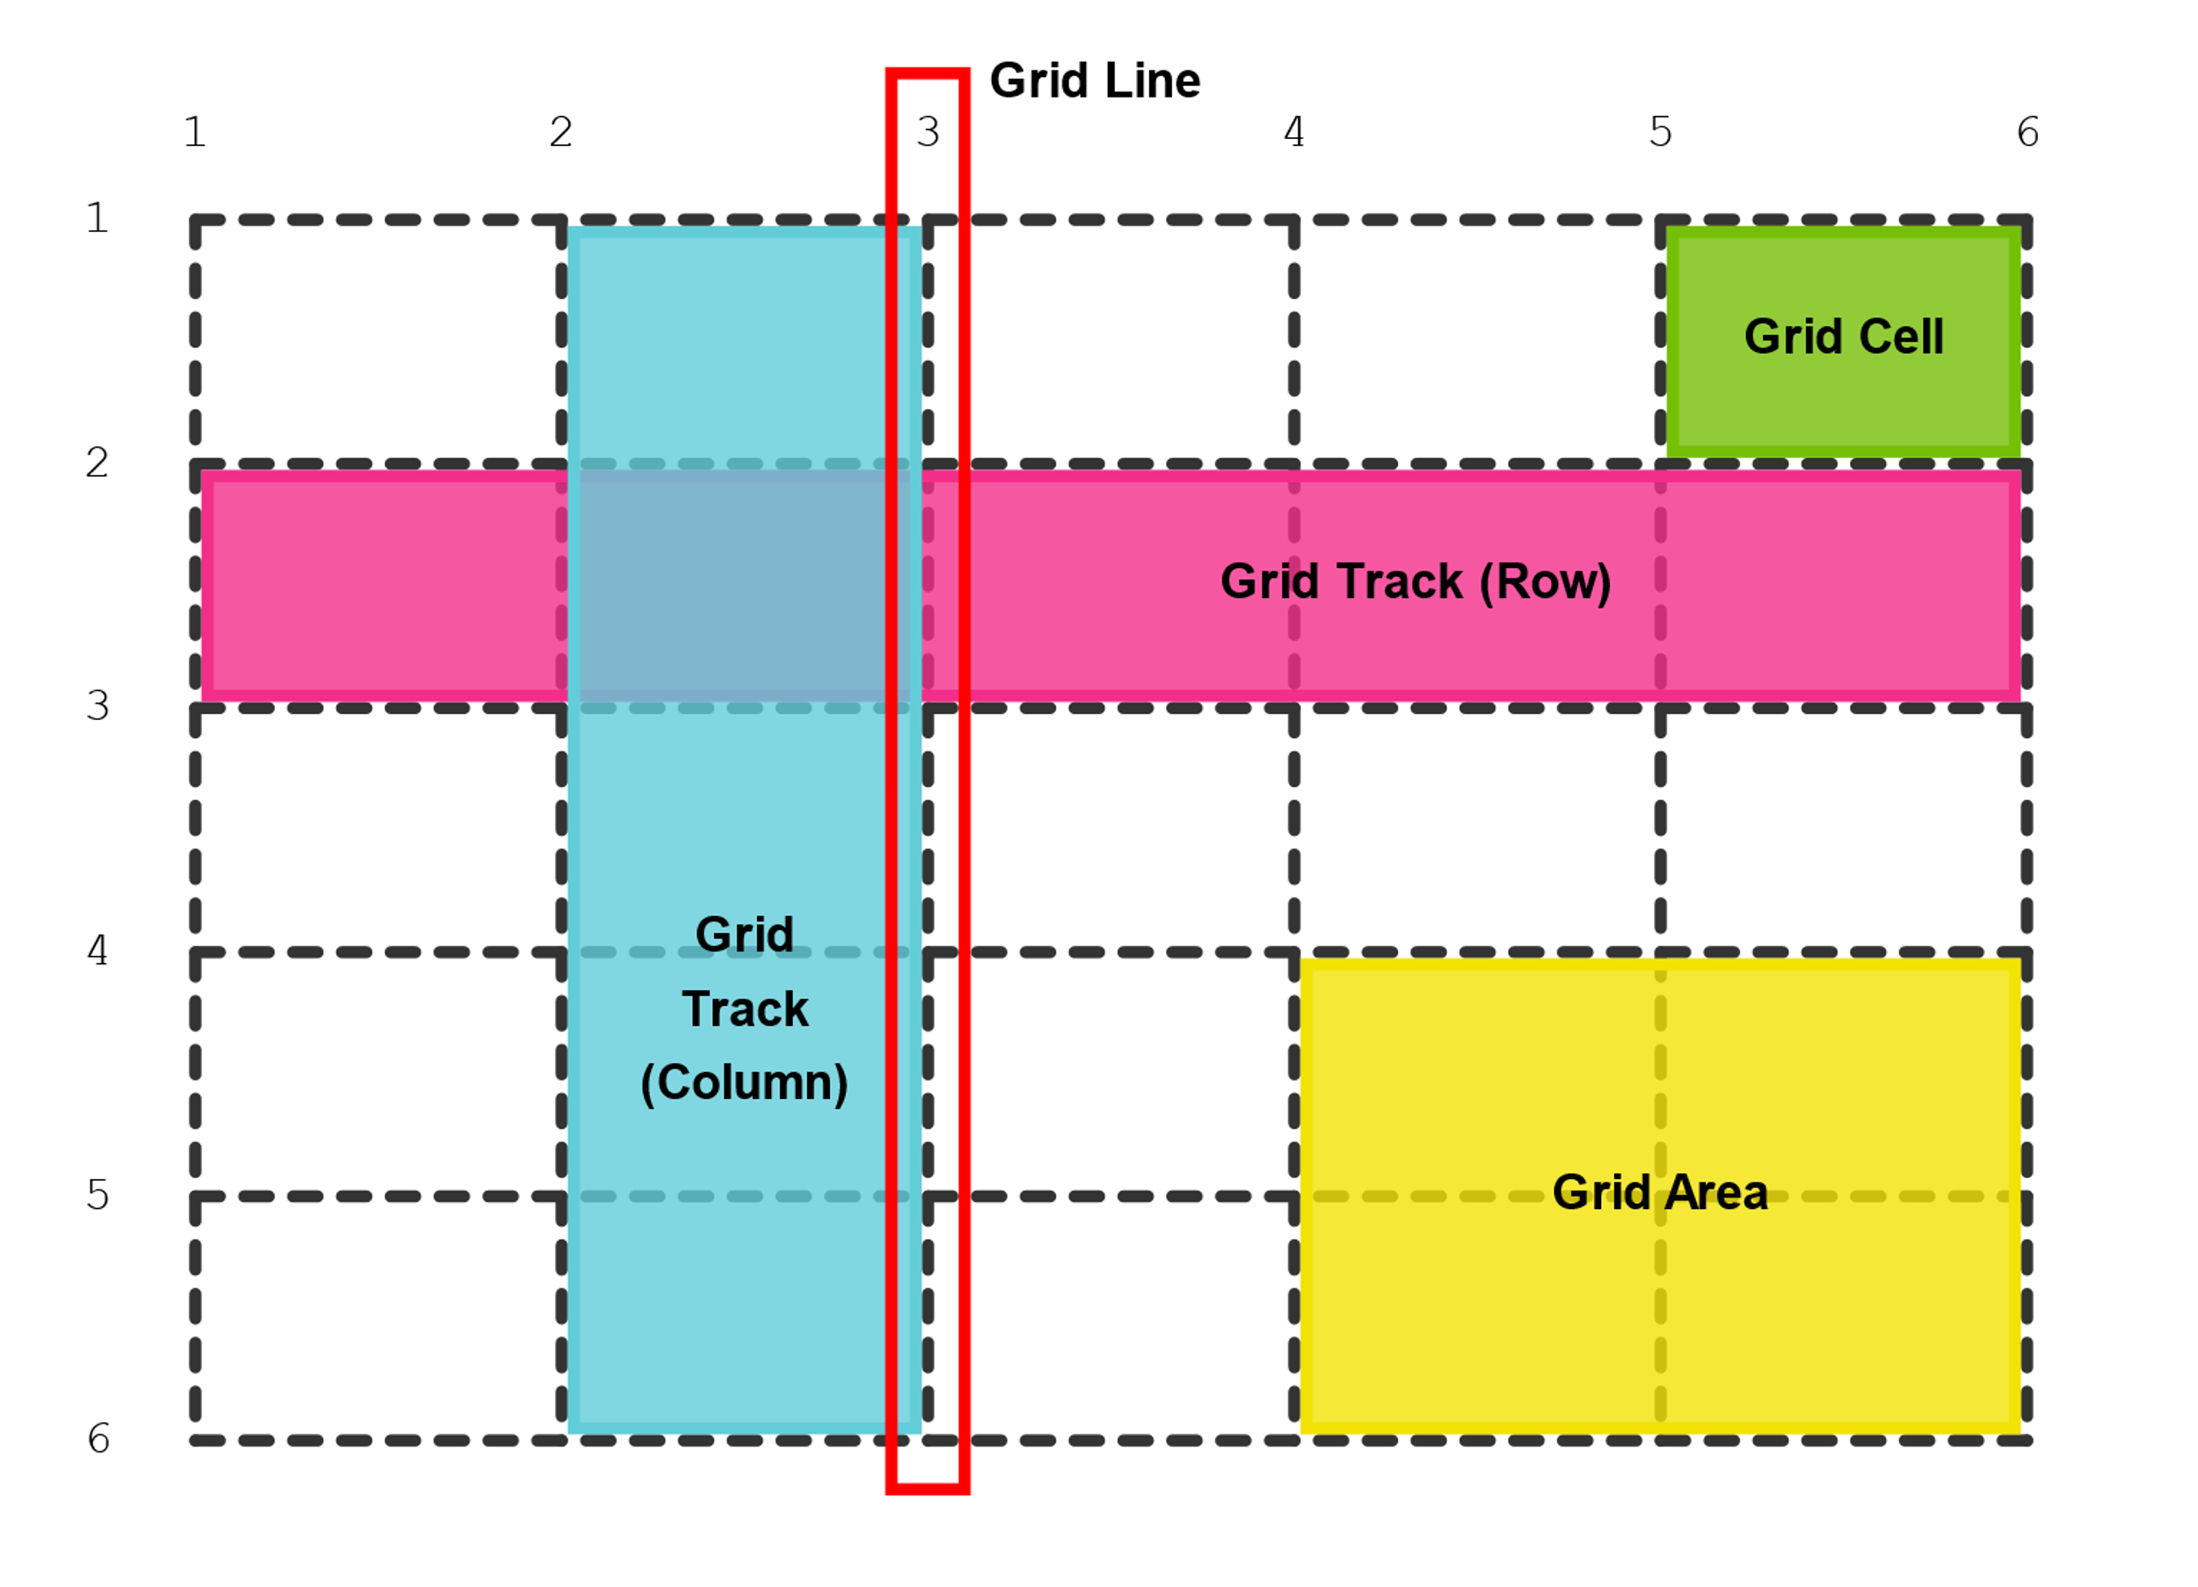
recap

Slide 27
CSS Media queries
CSS media queries are a powerful tool for creating responsive web design, ensuring that your web page adapts and looks good on a variety of devices and screen sizes.

Slide 28
CSS Media queries demo
https://www.w3schools.com/css/tryit.asp?filename=tryresponsive_mediaquery

Slide 29
CSS Media Queries and Breakpoints
Breakpoints generally follow some pattern:
Mobile: Less than 600px
Tablet: 768px to 991px
Desktop: 992px to 1200px
Large desktop: 1200px and up
https://www.w3schools.com/howto/howto_css_media_query_breakpoints.asp

Slide 30
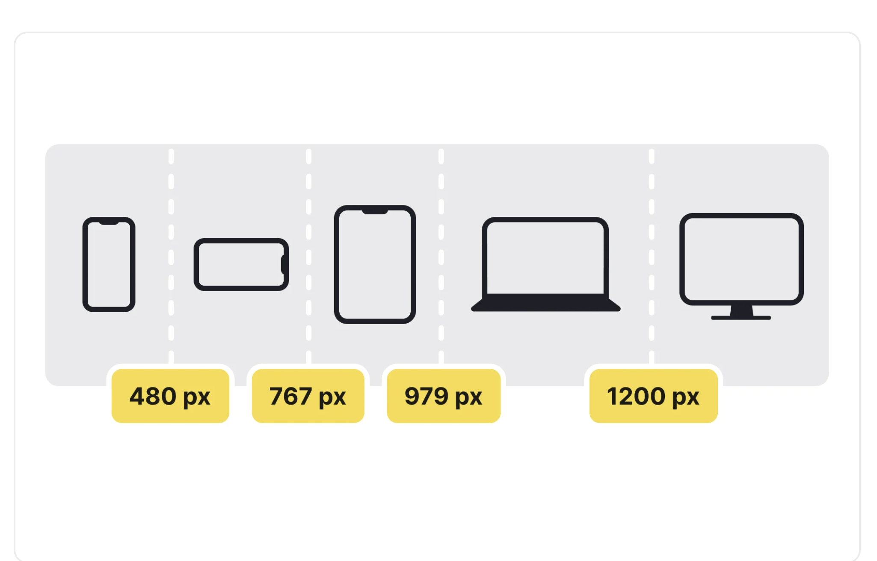
Source: https://app.uxcel.com/glossary/breakpoint

Slide 31
Media Query from KodetilWeb
https://koder.systime.dk/?id=136&L=1#c732
Question: which breakpoints is used in this example?

Slide 32
RWD workflow
step-by-step guide:
Start with a Mobile-First Approach: Begin by designing and developing the mobile version of your website
Define Breakpoints: Determine the breakpoints at which your website's layout and design will adapt to different screen sizes.
Design
Develop kode
Test and Optimize

Slide 33
RWD Case study
Kode

Slide 34
Reference- RWD , Flex & Grid
https://www.w3schools.com/css/css3_flexbox.asp
https://www.w3schools.com/css/css_rwd_intro.asp
https://www.w3schools.com/css/css_grid.asp
https://medium.com/@daniaherrera/responsive-design-layout-patterns-70e710551818

